Slide 1
My New Car
Autumn and Logan 2nd
I have no kids and a score of 730

Slide 2
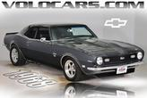
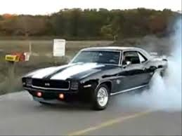
21,000$
BODY OFF FRAME RESTORATION.
SHOW QUALITY.,
SHOW QUALITY BODY OFF FRAME RESTORATION ON THIS PERFORMANCE SS.
IT'S DETAILED FROM CHASSIS TO TRIM. THIS SMALL BLOCK WILL SPANK A LOT OF BIG BLOCKS.
IT IS ONE OF THE SWEETEST SOUNDING CARS WE HAVE. THE CHASSIS IS COMPLETELY REBUILT.
NEW BALL JOINTS, BUSHINGS, SPRINGS,
ETC. HAS ADJUSTABLE TUBULAR REAR CONTROL ARMS. HAS FRAME CONNECTORS. MOTOR IS PROFESSIONALLY PERFORMANCE BUILT BY SPEED SHOP.
HAS ALL SPECS.
ITS A 4 BOLT MAIN, WITH ALL THE BEST PARTS.
DYNO TUNED AT 410 HP AND 390 LBS OF TORQUE.
HAS ALUMINUM HEADS, MSD IGNITION, HI-RISE INTAKE AND HOLLEY CARB.
COATED HEADERS AND A BEAUTIFUL CUSTOM BENT EXHAUST. FINNED ALUMINUM OIL PAN AND TRANS PAN.
NEW UPGRADED 4 WHEEL DISC BRAKE SYSTEM.
BUILT TURBO 350 TRANS WITH 2,500 STALL AND HURST SHIFTER.
GLASS FINISH PAINT ON LASER STRAIGHT BODY. ALL TRIM, EMBLEMS, HANDLES ETC ARE ALL NEW. TINTED GLASS.
NEW BILLET SPECIALTY WHEELS, MEATY IN BACK FOR AGGRESSIVE LOOK, BFG TIRES. SHOW QUALITY DELUXE INTERIOR. UPGRADED GAUGES, STEERING WHEEL AND ROLL BAR WITH FULL REAR SEAT. VERY METICULOUS ON EVERY LEVEL.INFORMATION IS TO THE BEST OF OUR KNOWLEDGE,

Slide 3
I have a credit score of 730.Which means I have a lower rate I have to pay,because I pay loans off on time.The rate of my loan is 3.6 on a car that is 21,000.I have five years to pay it off. I=prt
Taxes: 1,732.50$ Principal+I
Title 500$ Total payback + Months
Total 22,732.50
Interest rate 0.0387
Loan term 5
interest on the loan 4,398.74
Total payback 27,732.74
monthly fee 452.18

Slide 4
My life
no kids minus -295$ off my bill.I also don’t eat out or get a haircut -55$.No cable or ethernet - 55.I have a bike to ride to work till i pay off my car.I only will use the car to get food and to travel up to 50 miles -75$ the bike is from my dad for he is too old to ride it.which totals to 480$ I don't pay.I pay 295$ per month.My house is awsome.

Slide 5
Honk honk beep beep toot toot

Slide 6
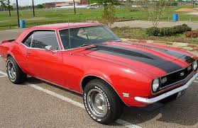

Slide 7
Most car models of the 60s have bad gas milage.
1968 camaro 25 per g
1968 mustang 14/20
1968 dodge 19
2000 camaro 29 per g
2000 mustang 21 pg
2000 dodge 24

Slide 8
repair cost and stuff
transmission 1,500$
brake line repair cost 400$average repair cost 367$ health 100$ daily cost 80$

Slide 9
Average insurance
230$ 1200$per year

